Slide 1


PPIT presentation
INDUS MOTOR COMPANY
MOHAMMAD YEHYA K213309
DANIYAL HAIDER K213433
HASAN IQBAL K213297

Slide 2

Introduction
Indus Motor Company (IMC) is a prominent automotive manufacturer in Pakistan, known for assembling and producing vehicles under the Toyota brand. Established in 1989 as a joint venture between Toyota Motor Corporation of Japan, the House of Habib, and other local investors, Indus Motor Company has played a significant role in the development of the automotive industry in Pakistan.

Slide 3

Company Overview
Website: https://toyota-indus.com/
Main Industry: Automotive Manufacturing Industry
Company Size: 2500-2600 employees
Headquarters: Karachi, Sindh
CONTINUE

Slide 4
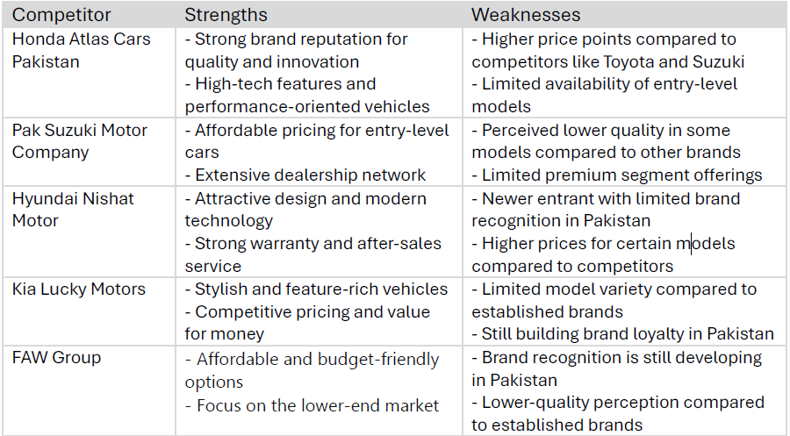
Competitors

Slide 5

Organizational
Structure
Functional
Hierachical
IMC organizes its operations based on specialized functions, such as:
Manufacturing and Operations
Sales and Marketing
IMC has a clear chain of command with distinct roles at every level, such as:
Board of Directors
Chief Executive Officer (CEO)

Slide 6

Feasibility of Structure
It aligns with the complexity and scale of our operations as a leading automobile manufacturer. The functional organizational structure allows us to specialize in critical areas such as production, sales, and supply chain management, ensuring that each department operates with a high level of expertise and efficiency. The hierarchical aspect provides a clear chain of command, which is essential for maintaining accountability

Slide 7


Values of your Company
At Indus Motor Company, our values are deeply rooted in the principles of quality, integrity, innovation, and customer satisfaction. We are committed to delivering products that exceed industry standards in terms of performance, safety, and sustainability. Our focus on integrity ensures that we operate transparently and ethically in every aspect of our business, building trust with our customers, employees, and stakeholders.

Slide 8

Strategic Insight
01.
02.
03.
Solution
Solution
Solution
Commitment to quality and reliability is central to our strategy. By adhering to the Toyota Production System (TPS) and employing stringent quality control measures, we consistently deliver vehicles that meet the highest global standards
Customer-centric approach is key to maintaining a strong market presence. We focus on understanding the evolving needs of our consumers, offering a diverse range of vehicles that cater to different market segments, and providing excellent after-sales support.
IMC’s emphasis on localization is another important factor. By sourcing materials and components locally, we reduce production costs and contribute to the growth of local industries

Slide 9

Any Questions?

